Slide 1
National
Breast Cancer Screening
Program
Dr. Rihab Alwotayan
Director of International Health Relations
Ministry of Health - Kuwait

Slide 2
Breast cancer burden in Kuwait
Breast cancer now represents the most common female malignancy in both the developing and developed world, and is the primary cause of death among women globally.

Slide 3
Breast cancer burden in Kuwait
Breast cancer is the most common female malignancy in Kuwait.
In 2013, 504 breast cancer cases were recorded by Kuwait cancer registry accounted for about 23.0% of all cancers and 50.0% of cancers among females.

Slide 4
Breast cancer burden in Kuwait
The age-standardized incidence rate (ASR) is 58.6 cases/100,000 among Kuwaiti females. The mean age at diagnosis (95% CI) is 54.1 (52.6-55.6) years for Kuwaiti females.

Slide 5
Breast cancer burden in Kuwait
Breast cancer survival rates vary greatly worldwide, ranging from 80.0% or more in North America, Sweden and Japan to around 60.0% in middle-income countries and below 40.0% in low-income countries.
The low survival rates in less developed countries can be explained mainly by the lack of early detection programs, resulting in a high proportion of women presenting with late-stage disease, as well as by the lack of adequate diagnosis and treatment facilities.

Slide 6
Kuwait National Mammography Screening Program
The program’s goal included reduction of breast cancer morbidity and mortality, an increased emphasis on community-based care, and an overall national health strategy for breast cancer screening.

Slide 7
Kuwait National Mammography Screening Program
The proposal was based on the compelling international scientific evidence that screening using mammography was effective in reducing mortality from breast cancer.
Its recommendations outlined the elements and potential organization of such a program, including the recommendation that at least 70% of women in the appropriate age group should be screened.

Slide 8
Kuwait National Mammography Screening Program
The program was announced in April 2014 and provides high quality, regular screening using mammography, meeting the international standards for early detection of small invasive cancers.
Age eligible women can book their screening mammography appointments without a primary care provider referral.

Slide 9
Kuwait National Mammography Screening Program
Screening services are delivered at 5 polyclinics, one in each of the Kuwait 5 medical health regions (Capital, Hawally, Farwaniya, Jahra and Ahmadi). These breast units, staff and equipment are monitored on ongoing basis by the main center which is situated in Al-Sabah medical health region to insure the delivery of high quality mammograms as part of the screening program.
In the first year of the program, KNMSP has provided screens for 2974 women, and has detected 26 breast cancers, the majority in the invasive stage.

Slide 10
Screening volume
Out of 164,000 Kuwaiti female (40yrs-69yrs) eligible to do screening mammogram in the coverage year (1/4/2016 -31/3/2017) of this report, 4203 screens. Which makes it a total of 11,100 screens done from 1/4/2014 to 31/3/2017.
Out of the 11,100 screens, 142 had breast cancer detected as the following:
  Year 1 (1-4-2014 to 31-3-2015): 26 out of the 2952 screens had breast cancer.
  Year 2 (1-4-2015 to 31-3-2016): 57 out of the 3945 screens had breast cancer.
  Year 3 (1-4-2016 to 31-3-2017): 56 out of the 4203 screens had breast cancer.

Slide 11
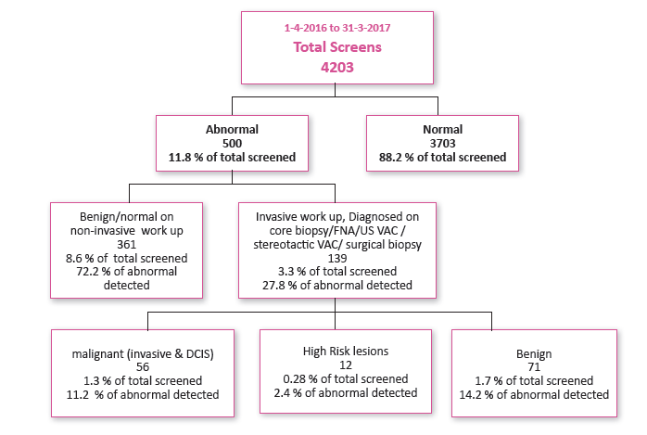
Screening outcome summary (1-4-2016 to 31-3-2017)

Slide 12
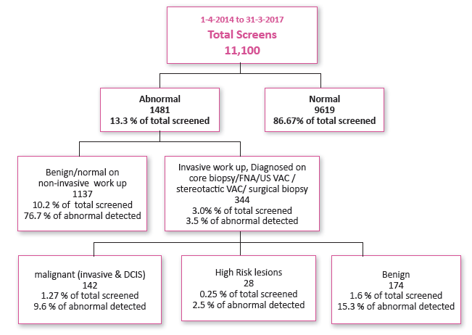
Screening outcome summary (1-4-2014 to 31-3-2017):

Slide 13
Program evaluation
Coverage: participation rate :
  The total number of Kuwaiti women (40 -69 yrs) eligible to do screening mammogram in the coverage year of this report (2016-2017) was 164,000. Out of this number, 4203 had screening mammography, and this accounted for 2.56% of the screen eligible Kuwaiti population.

Slide 14
Program evaluation
Retention Rate:
  The percentage of screen-eligible women in Kuwait who were rescreened within 30 months of their previous program screen for initial and subsequent screens was 0.8% of total population and 11.8% of screened women during the period 1-4-2014 to 31-3-2017 (n= 1309 ).

Slide 15
Program evaluation
Follow up: abnormal call rate
  11.8 % of screened women had recall due to abnormal result for which extra imaging was done in terms of additional mammographic images and/or breast ultrasound.

Slide 16
Program evaluation
Quality of screening: positive predictive value
  PPV is the % of abnormal cases with completed follow up found to have breast cancer (DCIS or invasive) after diagnostic work up. PPV1 is 10.0% and PPV3 is 28.8%. 1.3% of screened women were diagnosed with screen detected breast cancer after completion of diagnostic work up.

Slide 17
Program evaluation
Quality of screening: sensitivity and specificity
  Sensitivity is the proportion of women diagnosed with a screen detected ductal carcinoma in situ (DCIS) and/or invasive breast cancer following completion of diagnostic assessment who had a positive screening test for breast cancer. KNMSP sensitivity is 94.9%.
  Specificity is the proportion of screened women without a diagnosis of DCIS and/or invasive breast cancer who had a negative screening test for breast cancer. KNMSP specificity is 88.1%.

Slide 18
Program evaluation
Detection: in situ breast cancer detection rate
  In situ breast cancer detection rate is the number of women detected with DCIS or LCIS during a screening period per 1,000 women screened. In situ breast cancer is also referred to as TNM stage 0 cancer.
  There were 10 women with DCIS. The in situ breast cancer detection rate was 2.4 per 1,000 women screened.

Slide 19
Program evaluation
Disease extent at diagnosis :
  The early stage invasive breast cancer detection rate was 45.6%. (n=21)

Slide 20
Summary and future directions
We aim in the future to increase breast cancer awareness campaigns to reach all women in Kuwait. We hope that in the years to come, we will screen more women, aiming to reach 70% of the population.
Moreover, we need to train more radiologists and technologists on screening mammography in order to open more breast mammography screening units throughout Kuwait.

Slide 21







Commitments made by world leaders to ↓ premature deaths from NCDs 2011-2018
2007 CARICOM Port-of-Spain Declaration on NCDs
2009 ECOSOC Doha Declaration on NCDs
2018
3rd HLM 


2018
2011
Moscow Declaration 
2015
SDGs 
2014
Outcome Document 

2015
AAAA 
2011
Political Declaration 

Slide 22
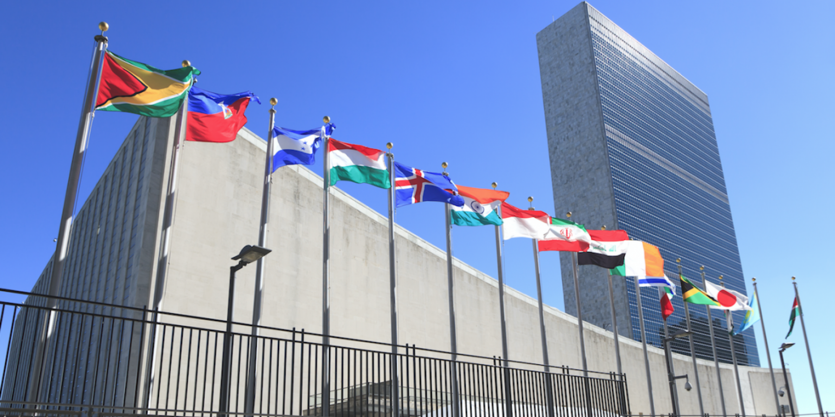

2018 UN Political Declaration on NCDs
13 new commitments
Reaffirms everything agreed upon in 2011, 2014 and 2015 (2030 Agenda)
Strengthens the role of Heads of State and Government
Transforms the 4 x 4 into 5 x 5 agenda
(= air pollution + mental health)
Reaffirms WHO leadership and coordination role for all work towards SDG 3.4
Commits governments to call on the private sector to become a more meaningful part of the solution

Slide 23
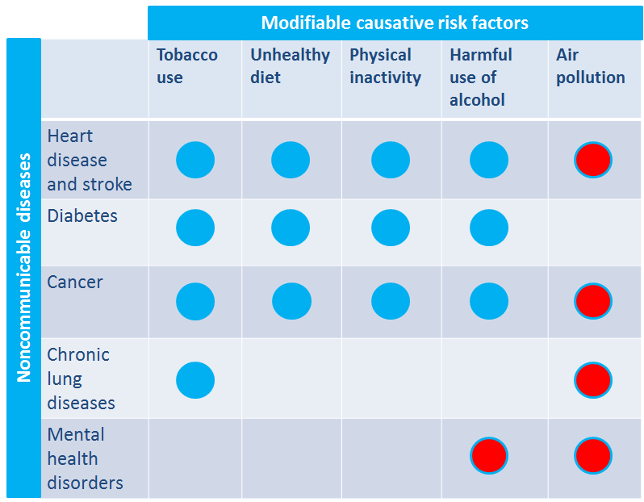
NCDs & their major lifestyle related risk factors the new 5x5 matrix

Slide 24


WHO Global Action Plan (GAP)
for the Prevention and Control of NCDs 2013-2020
Vision
A world free of the avoidable burden of noncommunicable disease.
Goal
To reduce the preventable and avoidable burden of morbidity, mortality and disability due to NCD by means of multi-sectoral collaboration and cooperation at national, regional and
global levels, so that populations reach the highest attainable standards of health and productivity at every age and those diseases are no longer a barrier to well-being or socioeconomic development.
Overarching Principles
Life-course approach ➢ Empowerment of people & communities
Evidence-based strategies ➢ Universal health coverage
Management of real, perceived or potential conflicts of interest
Human rights approach ➢ Equity-based approach
National action and international cooperation and solidarity
Multi-sectoral action.
Notes:
Tell the participants that the World Health Assembly endorsed the WHO Global Action Plan for the Prevention and Control of NCDs 2013-2020 in May 2013.
The Global Action Plan gives Member States, international partners and WHO a plan of action and a menu of policy options which, when implemented collectively between 2013 and 2020, will contribute
to progress on nine global NCD targets to be attained in 2025. This includes a 25% relative reduction in premature mortality, shown in the next slide

Slide 25
EMRO Regional Framework for Action on NCD
A regional roadmap to translate global commitments
Notes:
At Regional level, moving from global commitments to country implementation has been supported by the adoption in 2012 of a Regional Framework for Action which sets the strategic directions for national country responses along four priority areas
governance,
prevention and reduction of risk factors,
surveillance, monitoring and evaluation and
health care

Slide 26

Updated Appendix 3 of the
WHO Global NCD Action Plan 2013-2020
Menu of policy options for each of the 6 objectives of the Global NCD Action Plan.
88 recommendations, including 16 “best buys” classified as “very cost-effective and affordable interventions for all Member States¹ ” covering both population and individual level interventions.
¹ Generate an extra year of healthy life for a cost that falls below the average annual income or GDP per person
https://www.who.int/ncds/management/best-buys/en/

Slide 27
NCD Best Buys and other effective interventions

Slide 28


SDGs & WHO's 13th General Programme of Work (GPW13) 2019-2023
Outcomes
3.1 Determinants of health addressed leaving no one behind
3.2 Reduced risk factors through multisectoral approaches
3.3 Health and well-being realized through ‘Health in all policies’ and ‘Healthy settings’ interventions
1 billion more people enjoying better health and well-being
1 billion more people benefiting from universal health coverage
1 billion more people better protected from health emergencies
Cross-cutting platforms
Improving human capital across the life-course
Preventing and controlling communicable and noncommunicable diseases
Climate change and environmental health

Slide 29

NCD investment case

Slide 30
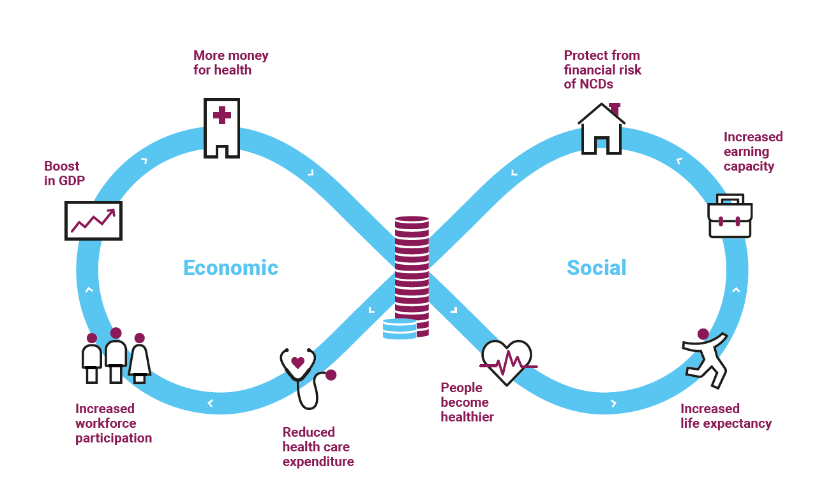
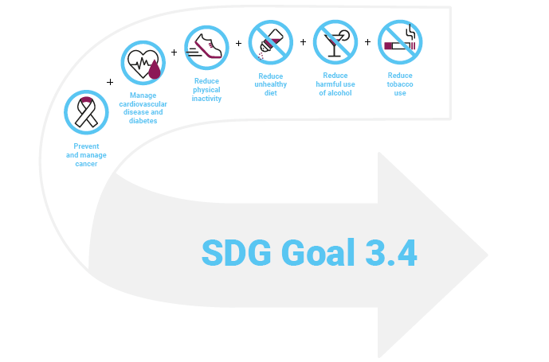
The value of preventing and controlling NCDs

Slide 31
Thank you

