Slide 1



Ending FGM Medicalization in the Arab States(Time to Act) 11-12 October 2023
FIGHTING FGM MEDICALIZATION IN GUINEA
Presented by Pr .M.Dioulde BALDE -CONAKRY

Slide 2
BACKGROUND
Prevalence of FGM is 95% among girls and women aged 15 to 49 (DHS GUINEA 2018), with a light decrease since the 2012 DHS(97% in the same age) For Girls aged 0-14: DHS_MICS-2012 (45.5%) and DHS-2018 (39%).
DHS 2018 reveals an increase in the medicalization of FGM:35% among girls under 15, compared with 31% in 2012 mainly by nurses and midwives (30.1%) and matrons (3.3%) in violation of the legal framework.

Slide 3
LEGAL, REGULATORY AND POLICY FRAMEWORK
INTERNATIONAL LEGAL INSTRUMENTS
Guinea has signed all the international conventions relating to the protection of children's rights
o United Nations Convention on the Elimination of All Forms of
Discrimination against Women.
o United Nations Convention on the Rights of the Child (CRC)

Slide 4
LEGAL, REGULATORY AND POLICY FRAMEWORK (2)
NATIONAL LEGAL INSTRUMENT
Guinea has revised its legal and regulatory framework to bring it into line with the international standards to which the country has subscribed.
Law L/2000/010/AN on Reproductive health
Joint decree No 2464 of 2010 prohibiting the practice of FGM in public and private health facilities in Guinea (Ministries of Health, Justice, Women’s Promotion and Children, Security and Territorial Administration).
Since 2016, Guinean legislation has made the practice of FGM a criminal offence, with aggravating circumstances for health care providers.

Slide 5
LEGAL, REGULATORY AND POLICY FRAMEWORK (3)
Law N°2016/059/AN of 26/10/2016 on the Penal Code
o Female Genital Mutilation is provided for and punished by articles
258 to 261 of the Penal Code in its Title II, Chapter V, Section II
Law N°2019/0059/AN of 30/12/2019 on the Children's Code
o Articles 774-782 on FGM, including Articles 779 to 782 concerning the practice of FGM by healthcare provider and the obligation to denounce and punish the practice of FGM.

Slide 6
CURRENT INITIATIVES AND INTERVENTIONS
o Strategic plan to promote the abandonment of FGM 2019-2023, including a specific strategic plan for religious leaders
o Training of 236 justice on the revised legislative provisions.
o Signing of a code of conduct for healthcare providers on the non-practice of FGM.
o Advocacy for the introduction of the FGM module in the training curricula of health schools.

Slide 7
CURRENT INITIATIVES AND INTERVENTIONS(2)
o Training of 45 health workers in the management of complications of FGM, respect for the code of conduct and introduction of FGM prevention into the ANC activity package.
Implementing a health system strengthening approach applying person-centered communication in ANC activity for the prevention of female genital mutilation in Guinea with projected Scale Up Application
o Start prosecuting health care providers who practise FGM (Example 2 cases in 2023: Mandiana and Kankan).

Slide 8
CHALLENGES
Respect for the code of conduct prohibiting the practice of FGM by health care providers.
Absence of a specific budget line in the Ministry of Health dedicated to the fight against FGM.
Weak application of legal provisions

Slide 9
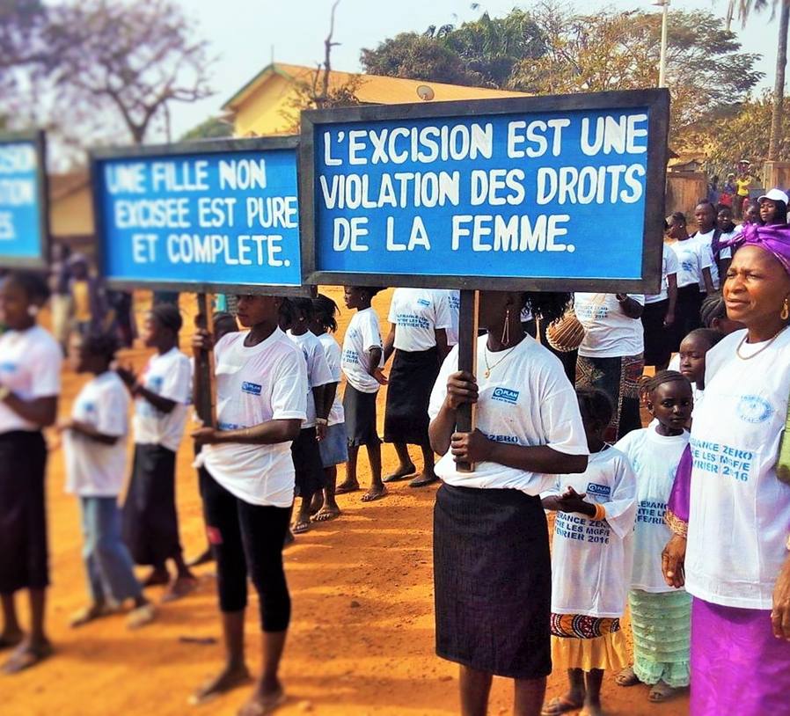
CONCLUSION
FGM and its medicalization remain a major concern in Guinea. However, the actions already undertaken and the prospects for the future augur well in the fight to eradicate the practice of FGM by health care providers in Guinea.

Slide 10
Own References about FGM
Balde MD, O’Neill S, Sall AO, Soumah AM, Diallo BA, Pallitto CC. Attitudes of health care providers regarding female genital mutilation and its medicalization in Guinea. PLoS One. 2021; 13;16(5):e0249998. 2
Balde MD, Soumah AM, Diallo A, Sall AO, Mochache V, Ahmed W, Touré AO, Diallo R, Camara S, O’Neill S, Pallitto C. Involving the health sector in the prevention and care of female genital mutilation: Results from formative research in Guinea. BMC Reproductive Health 2022;19(156).
Ahmed W, Mochache V, Stein K, Ndavi P, Esho T, Balde MD, Soumah AM, Diriye A, Ahmed MA, Petzold M, Pallitto C. A hybrid, effectiveness-implementation research study protocol targeting antenatal care providers to provide female genital mutilation prevention and care services in Guinea, Kenya, and Somalia. BMC Health Serv Res. 2021 Feb 1;21(1):109.

Slide 11
4. Balde MD and Ndavi PM, Mochache V, Soumah A-M, Esho T, King’oo JM, Kemboi J, Sall AO, Diallo A, Ahmed W, Stein K, Nosirov K, Thwin SS, Petzold M, Ahmed MA, Diriye A, Pallitto C. A cluster randomized trial of a health system strengthening approach applying person-centered communication for the prevention of female genital mutilation in Guinea, Kenya, and Somalia (manuscript under review ).
5. Soumah A-M, Esho T, Milford C, Mochache V, Balde M, Ndavi PM, King’oo JM, Kemboi J, Sall AO, Diallo A, Ahmed W, Stein K, Nosirov K, Thwin SS, Petzold M, Ahmed MA, Diriye A, Pallitto C. Implementing a health system strengthening approach applying person-centered communication for the prevention of female genital mutilation in Guinea, Kenya, and Somalia: Findings from a process evaluation of a cluster randomized trial (manuscript under preparation, 25 May 2023).

