Slide 1

PAEM Roadmap
PAEM Committees (TSO & ARC)
12 May 2024
Andrew Claxton
External Expert, Energy Department, League of Arab States

Slide 2
Context
The PAEM Plan (or ‘Roadmap’) should guide the work needed, with an emphasis on the next couple of years
Currently a draft, it needs to be considered and adopted by PAEM committees (ARC and TSO Committee) once formed. It then becomes their responsibility to deliver the Plan
Proposed plan prepared by LAS External Expert together with the Steering Committee

Slide 3
Challenges facing the PAEM
Physical network limitations
  Strategic: Mashreq-GCC, Maghreb-Mashreq
  National interconnections and internal networks
  European interconnections
Political challenges
  Lack of strong legal/regulatory framework (cf Europe, USA)
  Differing national priorities and situations
Practical impediments
  Motivation to trade
  Contractual basis to trade
  Access to non-bordering counterparts

Slide 4
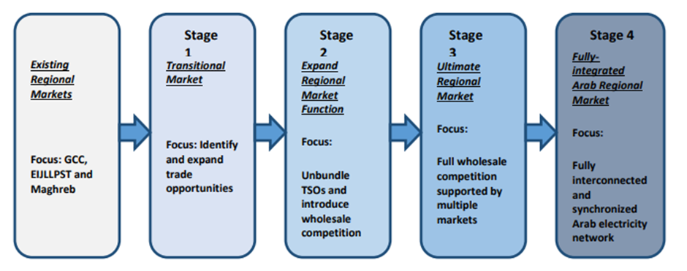
PAEM development stages
Source: World Bank, Operationalizing the ARC and TSO Committees

Slide 5
Stage 1: Multilateral trading – Market model
Ability to trade with anyone in the connected region, not just with bordering countries
Typical features:
Price-based trading/competitive price discovery (trading-in-kind also supported)
Bilaterally negotiated trading agreements (terms, price, etc)
Variety of products traded: long-term or spot; base or shape
Wheeling pre-arranged (obligation to offer; fair compensation for transit countries for infrastructure cost and losses)
Open, non-discriminatory access to cross-border capacity
Obligations and penalties for unscheduled deviations
Open to any qualified market party – potentially including independent parties with grid access
Further enhancements possible (e.g., day-ahead auctions), but multilateral trading will always be a core component of the PAEM

Slide 6
Geographic development
Strategic regional developments that determine the geographic scope of the connected PAEM region.
KSA-Egypt (3000MW, 2025) and GCCIA-Jordan-Egypt (500MW, 2025-6). Links GCC and Mashreq sub regions
Libya internal reinforcement/HVDC link (date TBD). Links Comelec and Mashreq/GCC
National connections/enhancements enabling countries to connect to the existing sub regional or regional solutions – e.g.:
Iraq-Jordan, Iraq-KSA, Iraq-Kuwait (500-1000MW, 2025-7)
Yemen-KSA (500MW, 2025)
International connections in particular capacity to Europe:
Morocco-Spain (additional 700MW, 2026)
Egypt-Greece (3GW, 2025+)
Tunisia-Italy (600MW)

Slide 7
Multilateral trading – implementation strategy
Current situation
Comelec
EIJLLPST
GCC
Not affiliated

Slide 8
Multilateral trading – implementation strategy
Step 1: GCC-Mashreq
Comelec
Combined GCC/
EIJLLPST
Link when
possible
Trigger: KSA-Egypt interconnector, 2025

Slide 9
Multilateral trading – implementation strategy
Step 2: GCC/Mashreq-Maghreb
PAEM region
Link when
possible
Trigger: Libya internal system reinforcement

Slide 10
Critical market arrangements
Arrangements required to support multilateral trading
Cross-border capacity calculation
Capacity allocation/ congestion management
Transmission services/wheeling
Unscheduled deviations
Market facilitation services
Data transparency
Market participation
PAEM Rules
Policies, rules, standards to be applied across region
As needed to ensure fair, efficient and operable market
Aligned national regulation/laws
Market Enablers
Market rules and participation terms
Supporting systems, procedures
Procurement of service providers
Governance structure for multiparty cooperations
Geographic scope
Physically connected grid
PAEM required minimum scope (sub-region, region)
Option for TSOs to cooperate more widely (e.g., clusters, sub-regions, region)

Slide 11
Multilateral trading – critical elements
Cross-border capacity calculation | Fair and reasonable method of calculation Treatment of pre-existing rights
Cross-border capacity allocation/congestion management | Open, non-discriminatory access for any qualified party Clear terms and conditions (e.g., firmness, rights, nomination) Method to handle congestion (demand exceeding availability): pro rata; explicit auctions (single or multi-border)
Transmission services (wheeling) | Reasonable cost recovery for transit networks (infrastructure costs, losses); fair basis for allocating costs to users Regulated charges, no trade-specific negotiation

Slide 12
Multilateral trading – critical elements
Unscheduled deviations | Incentives on all countries to flow as scheduled Fair compensation for costs imposed on others due to deviations
Market facilitation | Identify most relevant services (voice broking, online platform, price reporting, price model) Appointment/supervision of market facilitator; building necessary competences and trust
Data transparency | Identifying the need for transparency: who needs what to be able to make rationale, efficient decisions Establishing accessible transparency platforms: national, regional

Slide 13
Multilateral trading – critical elements
Market participation: Qualified counterparts | Ability to trade with as many potential counterparties as possible Establish master bilateral agreements setting out key terms - e.g., invoicing and payment, guarantees, performance assurance, etc.
Market participation: Trading competencies | Capable traders maximizing economic gain for both generation and supply: need to separate generation from supply? Adequate authority, resources (legal, financial, systems), focus, and motivation Detailed understanding of own marginal costs
Market participation: New market parties | Recognizing benefits of widening market access Associated changes needed to support independent parties: domestic and cross-border

Slide 14
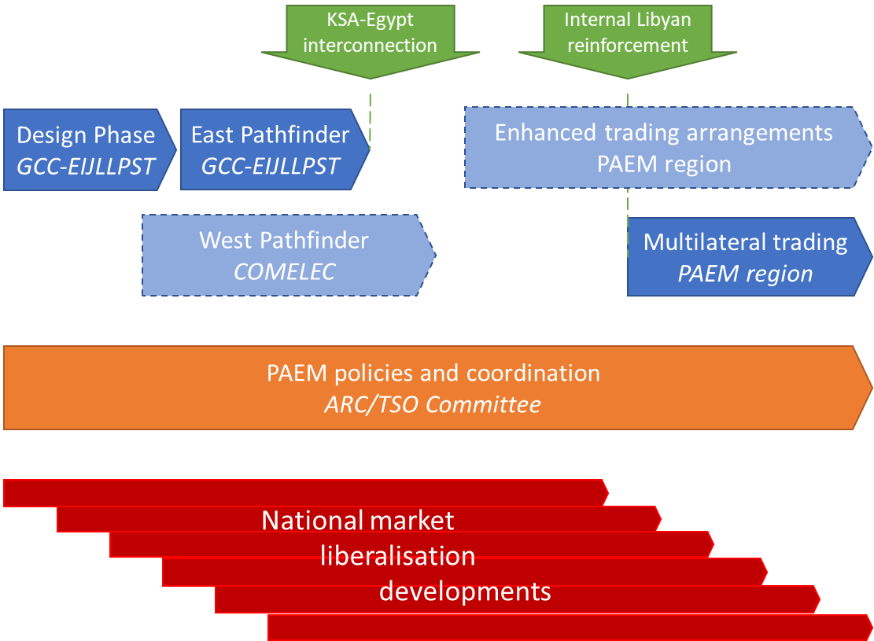
High Level Plan (Stage 1)

Slide 15
High Level Plan (Stage 1)
Pathfinders project(s) to develop multilateral trading:
  East Pathfinder: KSA-Egypt-Jordan to enable trade across EIJLLPST and GCC once KSA-Egypt interconnector operational (2024/5), followed by Jordan-KSA and Iraq-GCC
  Potential West Pathfinder in Comelec; Libya internal reinforcement would enable linking of PAEM
Ensure alignment between the Pathfinders and consistency with the emerging PAEM rules (TSO Committee/ARC)
Further enhancements to the trading arrangements to be added over time
Development of national markets not a PAEM obligation; PAEM market design should support a range of national market forms

Slide 16
Stage 2: Liberalised national markets
Typical elements:
  Unbundle TSO, independent regulation
  Enable generation competition – e.g.: IPPs (with and without PPA), private RES, separate national utility supply and generation, breakup generation, demand side participation
  Consumer choice of supplier: large users; small/domestic
  Access to cross-border market for independent participants
Different ways to develop national markets
  Isolated development (adequate scale?)
  Cluster of coupled markets
  Link to adjacent developed market
Approach and timing will vary between countries
PAEM does not impose any obligation to liberalise

Slide 17
Stages 3/4: Fully liberalised, integrated markets
Likely to be based broadly on European model
Focus on spot markets (day ahead, intraday)
  Coupled: cross-border capacity allocated automatically
  Cleared: trading against a central counterparty
Principal spot market designs:
  Continuous markets
    Bid-offer online negotiation/matching
    Able to run close to delivery
    Potential early enhancement to Stage 1
    Potential to link to European market (single intraday coupling)
  Auction-based markets
    Periodic market
    Single clearing price in each period
    Liquidity critical to getting trusted price formation

Slide 18
Roadmap main objectives
Establish and build capacity of the TSO and ARC committees; set out a plan for the target organisation and resourcing of the PAEM, including committee structure and support functions, and have initiated a transition to this structure
Establish the necessary PAEM rules that should apply across the region, within which sub-regions can have some flexibility in their approach where appropriate
Design, implement and test the necessary market enablers to support multilateral trading in at least one pathfinder area. Set out a plan for the further development and phased geographic rollout of the arrangements
Provide support to the development of trade and market liberalisation in individual member states

Slide 19
Near term Workplan Priorities
Development of PAEM rules and institutions
Progress East Pathfinder project: design phase
Assist development of national competencies and capabilities

Slide 20
Proposed high-level deliverables, 2023-4
PAEM Rules and Institutions
Led by Steering Committee with AEEC oversight until ARC and TSO Committees formed
Deliverable |  | Comment
1 | Build understanding at ARC/TSOC of key concepts (executive perspective) | World Bank knowledge building
2 | Develop a methodology for calculating Net Transfer Capacity | International experience input
3 | Establish principles for the remuneration of transmission services (wheeling, etc) | World Bank support
4 | Establish the shared data requirements/ definitions and specify the required functionality for a data platform | International experience input, including Med-TSO
5 | Plan for migration to enduring institutional structure, Market Facilitator | LAS role and AFESD funding ends 2023

Slide 21
Goals of the East Pathfinder
Develop and build the mechanisms and tools needed to support multilateral trading between countries in the GCC and EIJLLPST sub-regions
Initial focus on trading between Egypt, Jordan and KSA
Able to quickly extend to all countries in the two sub-regions – potential basis for PAEM
Includes designing and implementing the necessary systems, processes, rules and agreements
Coordinate closely with the ARC and national regulators
Establish project under the PAEM

Slide 22
Indicative Pathfinder timeline
2024
2025
2026
Develop PAEM market rules
TSOC/ARC
Alignment, coordination
Pathfinder Design Phase
KSA, Egypt, Jordan TSOs
Pathfinder Implementation Phase
Regulatory approval
Launch Multilateral Trading KSA/E/J
Progressive
rolloutzzz
Preparation in other countries
Initiation of East Pathfinder currently awaiting approval

Slide 23
Further Considerations
Med-TSO
Med-TSO is supporting two pilot initiatives to develop cross-border markets between countries in the Maghreb and Mashreq subregions. There is clear overlap with the PAEM that should be aligned; and the Med-TSO work is also potentially a very valuable input to the Pathfinders and PAEM.
PAEM User Group
Establishing a PAEM User Group comprising representatives from the single buyers/national utilities responsible for trading could be a valuable way to establish what should be the priorities for the PAEM, as well as provide a forum for sharing experience on internal organisation and resourcing best practice.

